Slide 1

Running Solr in SolrCloud Mode Local File System version 4.10.3

Slide 2
Agenda
Introduction
SolrCloud High-Level Overview
Live SolrCloud Demo
Solr Directory Structure
SolrCloud Parameters
Solr Logging
Sample SolrCloud Start-up script
Resources

Slide 3
SolrCloud High-Level Overview
Scalable
Fault Tolerant
Data Redundancy
Advance analysis/tokenization capabilities
Automatic Load Balancing
NoSQL Database
Easy to integrate with new and existing systems.
Requires very little effort to setup a small SolrCloud cluster.
Runs on Linus, OS X and Windows
Local File System
Cloudera HDFS
Hortonworks HDFS

Slide 4
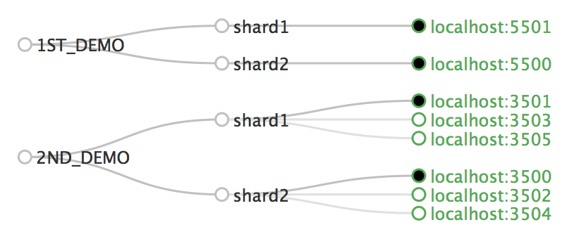
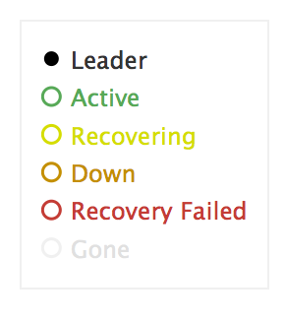
SolrCloud High-Level Overview
Solr Node
Shard
Core
Leaders
Replicas
Collection

Slide 5
SolrCloud Overview
Instructs Solr How to behave
solrconfig.xml
schema.xml
solr.xml
core.properties

Slide 6
Downloads
Download Solr version 4.10.3 http://lucene.apache.org/solr/
Download Zookeeper version 3.4.6 http://zookeeper.apache.org/
Download sample SolrCloud scripts https://github.com/gutierrezga00/SolrCloud_LocalFileSystem
Unzip Files preferably to your Desktop

Slide 7
Live Demo

Slide 8
Zookeeper Configurations
Create a “zookeeper” folder under your /tmp directory.
Create a “data” sub-folder under your /tmp/zookeeper directory.
Make a copy of the zoo_sample.cfg file and name it zoo.cfg Location: zookeeper-3.4.6/conf/zoo_sample.cfg
Modified the zoo.cfg file and set the following parameter names: dataDir=/tmp/zookeeper/data clientPort=9181

Slide 9
Start Zookeeper
cd zookeeper-3.4.6/bin
To Start Zookeeper enter the following command: zkServer start
To Stop Zookeeper enter the following command: zkServer stop
To clean/reset Zookeeper enter the following commands: zkServer stop rm –rf /tmp/zookeeper/data/* zkServer start

Slide 10
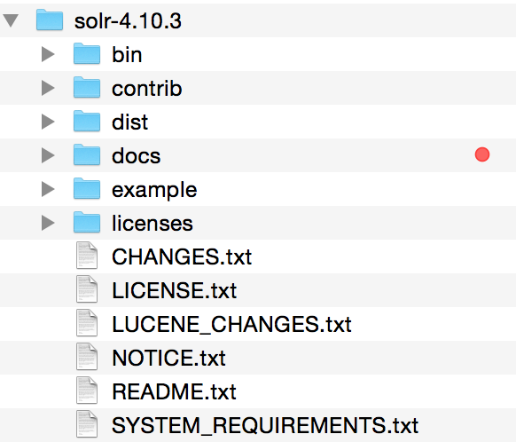
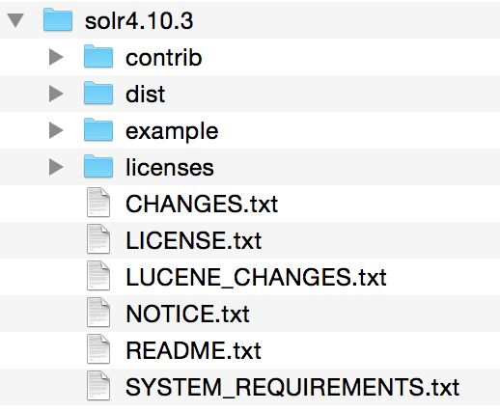
Solr Directory Structure
Solr 4.10.3 AFTER
Solr 4.10.3 DEFAULT

Slide 11
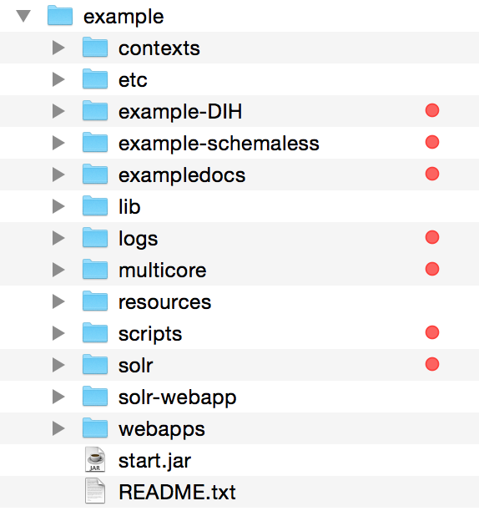
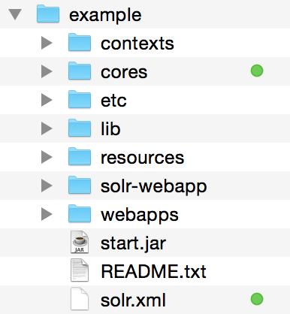
Solr Directory Structure
Solr 4.10.3 AFTER
Solr 4.10.3 DEFAULT

Slide 12
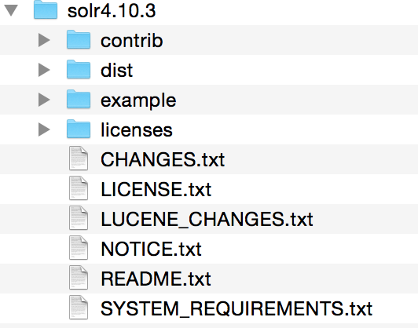
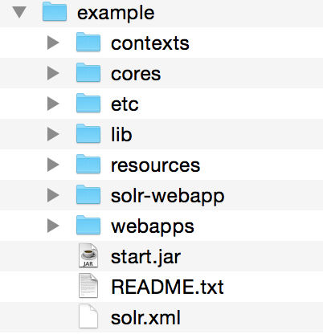
Solr Directory Structure
FINAL DIRECTORY STRUCTURE

Slide 13
SolrCloud Parameters
ZOOKEEPER - zkRun vs. zkHost zkRun: Solr Internal Zookeeper (Development Setup) zkHost: External Zookeeper (Production Setup)

Slide 14
SolrCloud Parameters
numShards – Determines the number of shard the SolrCloud index will be comprise across multiple machines (servers).
bootstrap_confdir – SolrCloud cluster configuration files (e.g. schema.xml, solrconfig.xml, etc).
collection.configName – SolrCloud collection name.
solr.solr.home – SolrCloud binaries location (e.g. example folder).
solr.data.dir – Shard location (HDFS or Local File System)

Slide 15
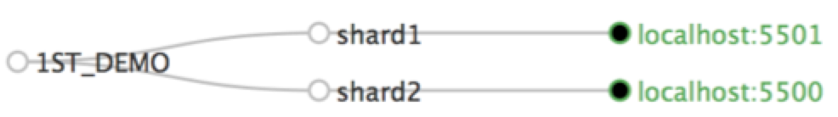
SolrCloud Parameters
host – Solr defaults to using the machine IP address. Using the “host” parameter you can overwrite the solr.xml host value within the <solrcloud> element. <str name="host">${host:}</str>
jetty.port – port number a shard will be listening

Slide 16
SolrCloud Logging
Solr controls all logging via the log4j.properties file. solr4.10.3/example/resources/log4j.properties
The property name “solr.log” by default is set to use the “logs/” directory within the Solr home directory. We purposely removed the logs/ directory.
Set the “solr.log” property name to make use of a passed in parameter value (e.g. solr.solr.logging) Before: solr.log=logs/ After: solr.log=${solr.solr.logging}

Slide 17
SolrCloud Bash Script
SolrCloud Parameters java ${SOLR_JAVA_OPTS} -Dbootstrap_confdir=${BOOTSTRAP_CONFDIR} -DnumShards=${NUM_SHARDS} -Dsolr.data.dir=${DATA_DIR}/${SHARD_DIR_NAME}$c -Djetty.port=${JETTY_PORT} -DSTOP.PORT=${JETTY_STOP_PORT} -DSTOP.KEY=${JETTY_STOP_PORT}${JETTY_STOP_KEYWORD} -Dsolr.solr.logging=${LOG_LEADERS}/${LOG_DIR_NAME}$c/ java ${SOLR_JAVA_OPTS} -Dsolr.data.dir=${DATA_DIR}/${SHARD_DIR_NAME}$c -Djetty.port=${JETTY_PORT} -DSTOP.PORT=${JETTY_STOP_PORT} -DSTOP.KEY=${JETTY_STOP_PORT}${JETTY_STOP_KEYWORD} -Dsolr.solr.logging=${LOG_LEADERS}/${LOG_DIR_NAME}$c/

Slide 18
Resources
Download presentation material https://github.com/gutierrezga00/SolrCloud_LocalFileSystem
Zookeeper: http://zookeeper.apache.org
Solr: http://lucene.apache.org/solr
Documentation: Solr Reference Guide https://www.apache.org/dyn/closer.cgi/lucene/solr/ref-guide

